Slide 1
Model Spotlight: Metrolina Regional Travel Demand Model, MRM25
NC Model Users Group, Fall 2025
Martin Kinnamon, PE
Regional Modeling, Analysis and Coordination Section Manager, CDOT

Slide 2





MRM Model Team Staff
Alex Riemondy
Senior Modeler
Martin Kinnamon
Section Manager
Marlee Henninge
TP III
Dewan Parvez
Travel Demand Modeler
Torrey Williams
Senior Modeler

Slide 3
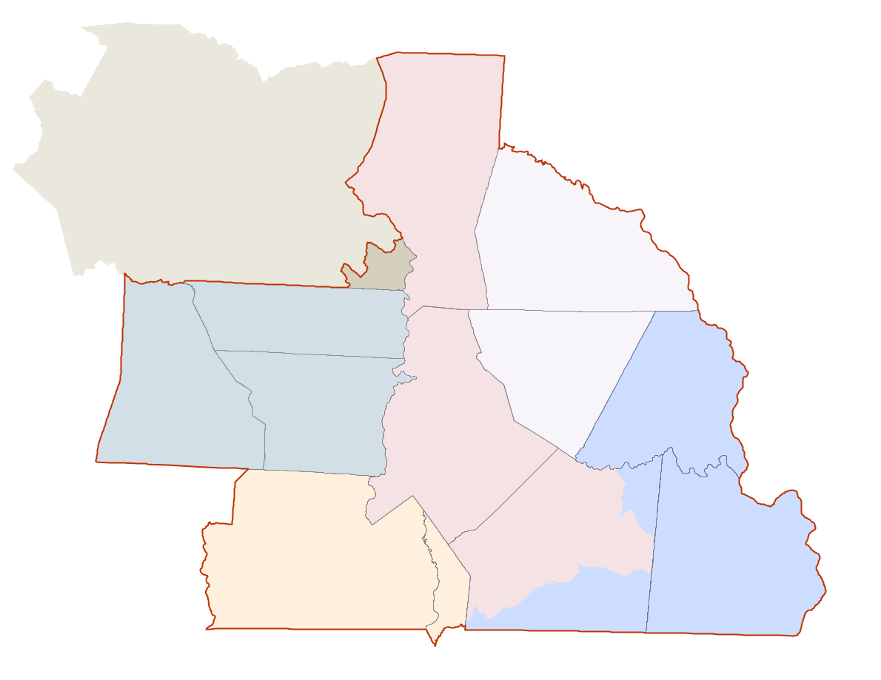
Metrolina Regional Model
Greater Hickory MPO
Cabarrus Rowan MPO
13 Counties
New! Anson
2 States
4 MPOs
2 RPOs
Gaston – Cleveland – Lincoln MPO
CRTPO
Rock Hill – Fort Mill
Area Transportation Study
Rocky River RPO

Slide 4
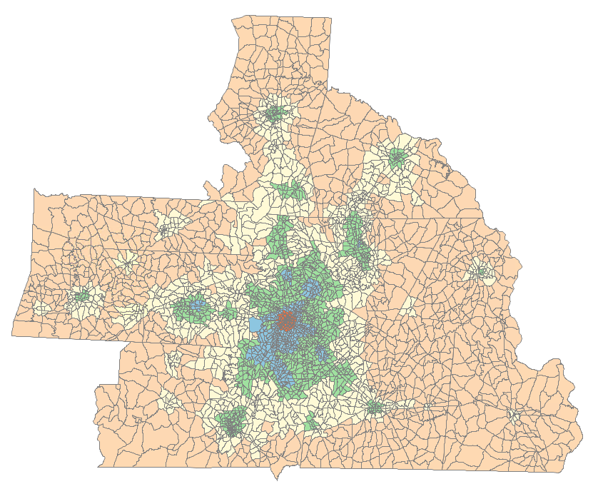
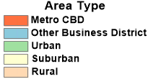
MRM Region
5,600 square miles
3,805 TAZs
2022:
Approx. 2.9M People in 1.2M Households
Approx. 1.7M jobs
2055:
Approx. 4.7M People in 1.9M Households
Approx. 2.5M jobs
Notes:
60% pop growth; current numbers of 157 people/day into region; Meck just under 40% of that

Slide 5
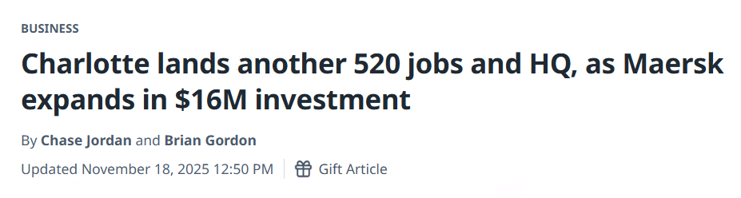

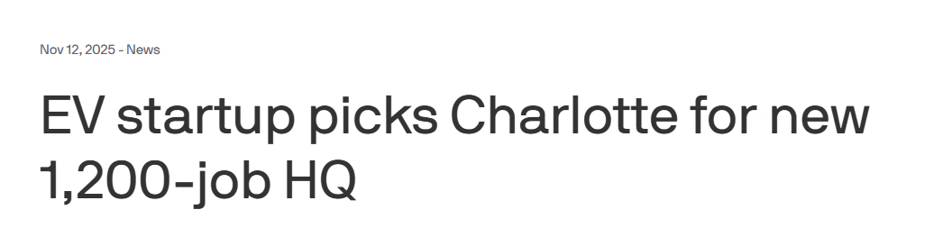
Fast Growing Region: Employment Announcements in last few weeks:

Slide 6
Input Updates in MRM25
Household Travel Survey
Conducted Fall 2023
5,200+ households
Transit On-Board Survey
Conducted Fall 2022
SE Data (household, employment, student enrollment)
2022 base year data (provided by MPOs)
County- and district-level totals updated Winter 2024
Independent demographer/economist (Fouth Economy)
Allocation to TAZs using CommunityViz (Coordinate Our Future, etc)
Roadway and Transit Networks
Webmap process
Added Anson County

Slide 7
MRM25 Updates -- Model components
Consultant Led (Caliper):
Update of previous tour models
Added tour-based Mode Choice Model
Moved intermediate stops after mode choice
Coding updates
In-house:
Commercial Vehicle model update
Coding updates

Slide 8
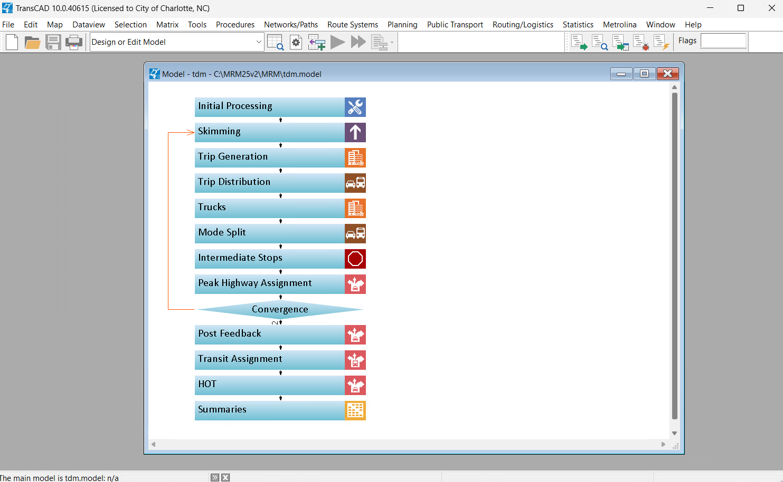
MRM25 Updates -- New Flowchart User Interface TransCAD 10

Slide 9
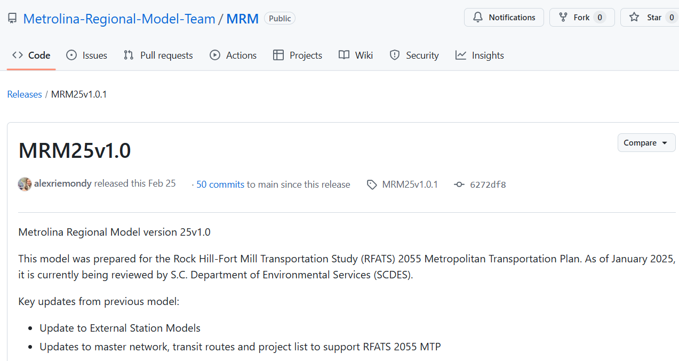
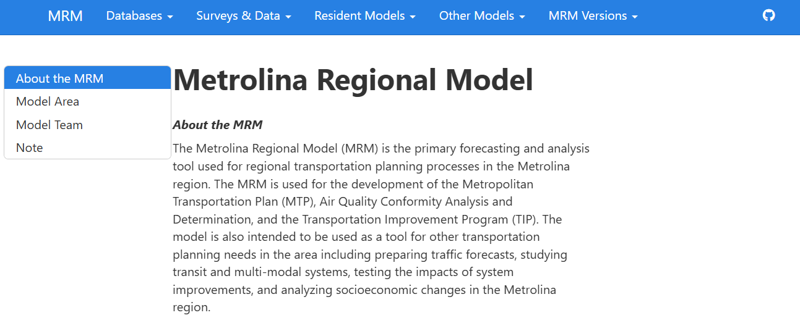
MRM25 Updates -- GitHub Tracking, Documentation, and Distribution

Slide 10
Simplified Tour-Based Model
Early 2000s
2014
2017 – 2019
April 2019
May 2022
January 2025
First Metrolina Regional Model (MRM) developed
Began work on tour-based model
Used 2012 HHTS and External Survey Data
Ran trip/tour-based model concurrently
Trip model was still the official version (MRM18v1.0)
MRM19v1.0 endorsed as the first instance of the tour-based model for the region
Second instance released (MRM22v1.0)
MRM25v1.0used for RFATS’ 2055 MTP

Slide 11
Trip vs Simplified Tour
Highway & Transit Skims
Highway & Transit Skims
Trip Generation
Tour Frequency
Feedback Skims
Feedback Skims
Trip Distribution
Tour Destination
Peak / Off-peak
AM / PM / Midday / Night
Feedback congested speeds
Mode Choice
Mode Choice
Feedback congested speeds
AM / PM / Midday / Night
Intermediate Stops
Trip Assignment
Trip Assignment

Slide 12
Key Benefit: Modeling Households
Avoid aggregation bias
using average data masks important differences
more accurate to model individual behavior
Improved reporting
more detailed cross-tabs of travel behavior
better understanding of how system changes affect certain individuals
helpful for Environmental Justice analyses

Slide 13
Tour Frequency
Logit equations instead of trip rates
Discrete choices for each household (not to TAZs)
Previous tours affect number of subsequent
Essentially creating a travel diary

Slide 14
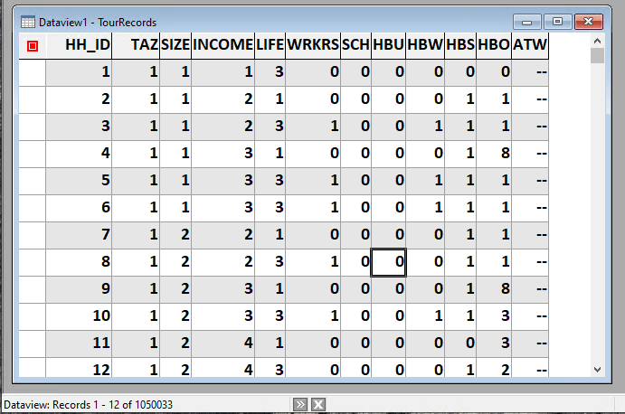

Slide 15
Tour Purposes
Similar to four-step model but are prioritized:
HBSchool
HBU
HBW
HBShop
HBOther
At-work after Destination Choice
No NHB
Purposes are interrelated in a household
More important purposes influence less important ones

Slide 16
MRM25 Versions -- Each uses the same core model and land-use data
MRM25v1.0
For RFATS’ 2055 MTP
Model Runs Submitted for Conformity Determination January 2025
MRM25v2
For NC’s 2026-2035 STIP
Model Runs Submitted for Conformity Determination June 2025
MRM25v3
For NC’s 2055 MTPs
Model Runs Submitted for Conformity Determination October 2025

Slide 17
MRM25 Validation
Region
Functional Class | # counts | Average Count | Average Assn | Assn/Cnt | RMSE
Freeway | 308 | 48,489 | 51,975 | 1.07 | 18
Expway | 49 | 32,176 | 37,421 | 1.16 | 33
Tfare | 2,823 | 13,087 | 12,530 | 0.96 | 34
Other | 693 | 2,941 | 2,350 | 0.80 | 73
All Facilities | 3,873 | 14,328 | 14,160 | 0.99 | 33.14
Volume Group | # counts | Average Count | Average Volume | Vol/Cnt | RMSE
<1,000 | 264 | 629 | 1,094 | 1.74 | 220.16
1,001-2,500 | 459 | 1,762 | 2,139 | 1.21 | 96.52
2,5001-5,000 | 556 | 3,747 | 4,213 | 1.12 | 68.04
5,001-10,000 | 847 | 7,436 | 7,422 | 1.00 | 43.29
10,001-25,000 | 1,239 | 16,093 | 14,924 | 0.93 | 29.42
25,001-50,000 | 499 | 34,253 | 33,981 | 0.99 | 23.64
>50,000 | 152 | 66,796 | 69,427 | 1.04 | 14.75
Total | 4,016 | 14,079 | 13,920 | 0.99 | 33.49

Slide 18
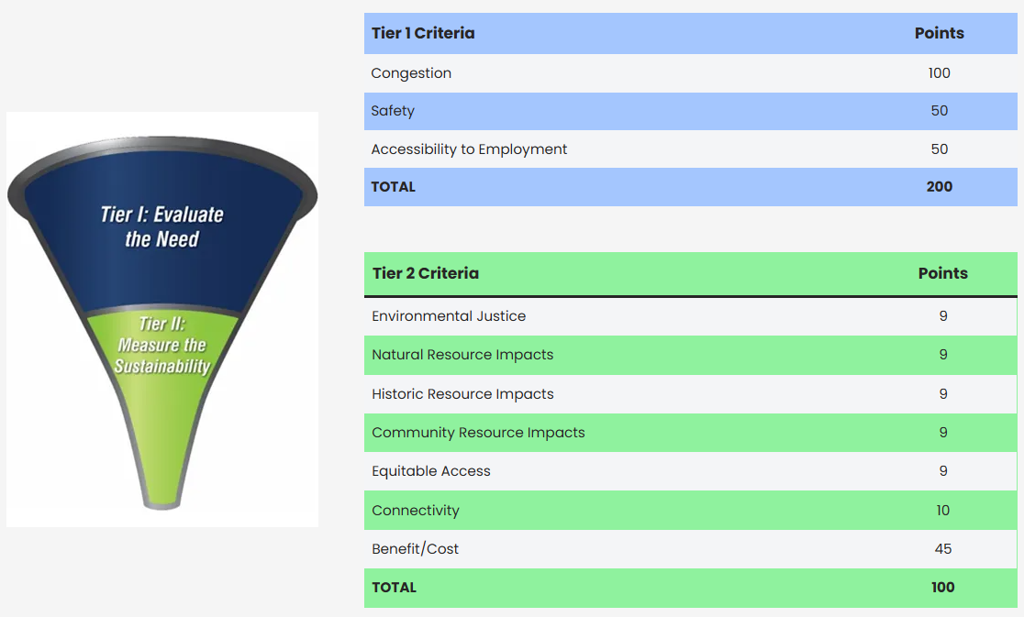
MRM Other Uses -- CRTPO 2055 MTP – Project Ranking

Slide 19
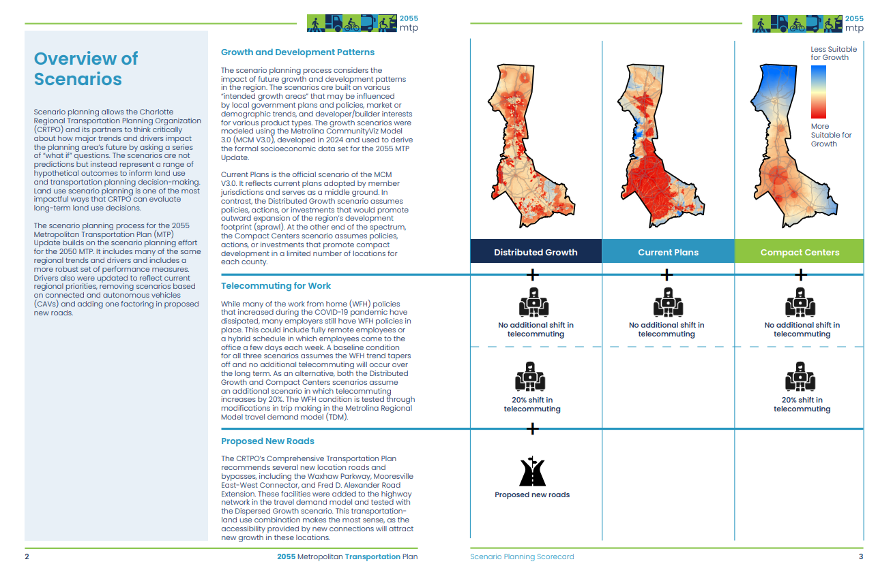
MRM Other Uses -- CRTPO 2055 MTP – Scenario Planning

Slide 20
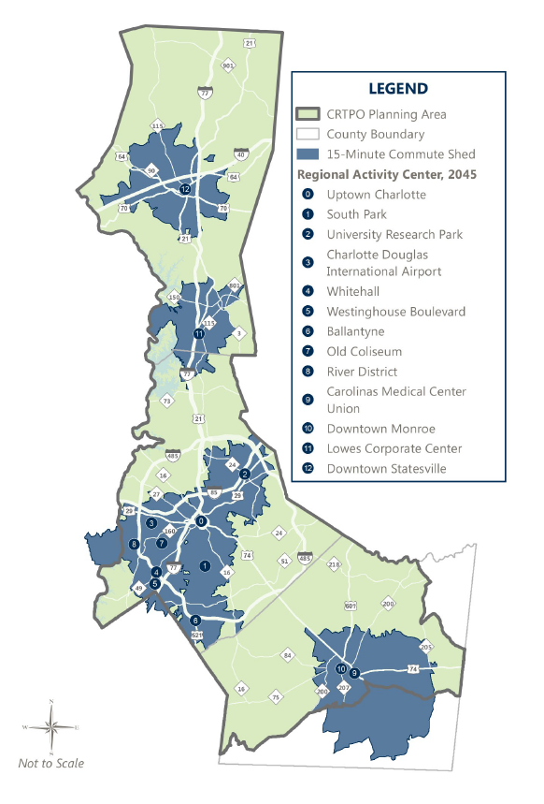
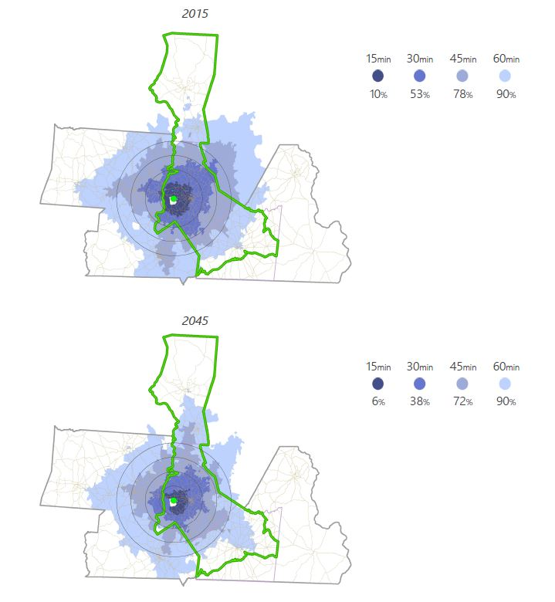
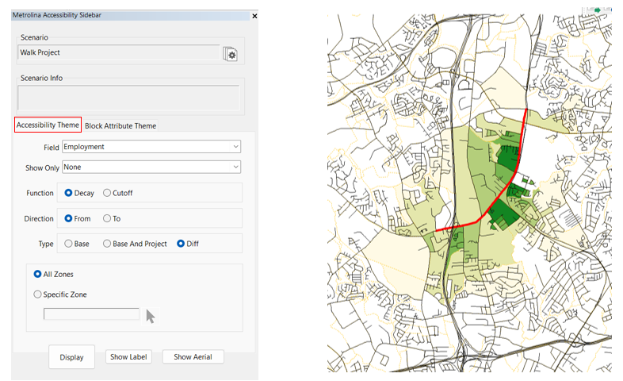
MRM Other Uses -- Accessibility

Slide 21
Next Steps
Land-use updates (begin late 2026)
External model updates
Incorporating new CATS on-board ridership survey
Continued sensitivity testing & validation work
Managed lanes/tolling update?
Next model base year will be 2026

Slide 22
For More Information:
Martin Kinnamon, PE
Program Manager
Metrolina Regional Model
martin.kinnamon@charlottenc.gov
(980) 721-8273

